Slide 1

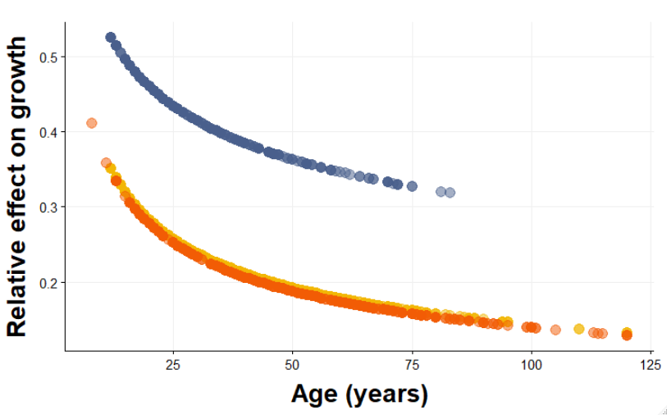
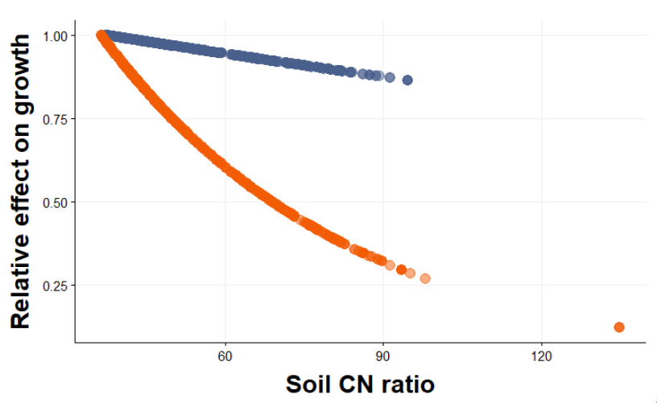
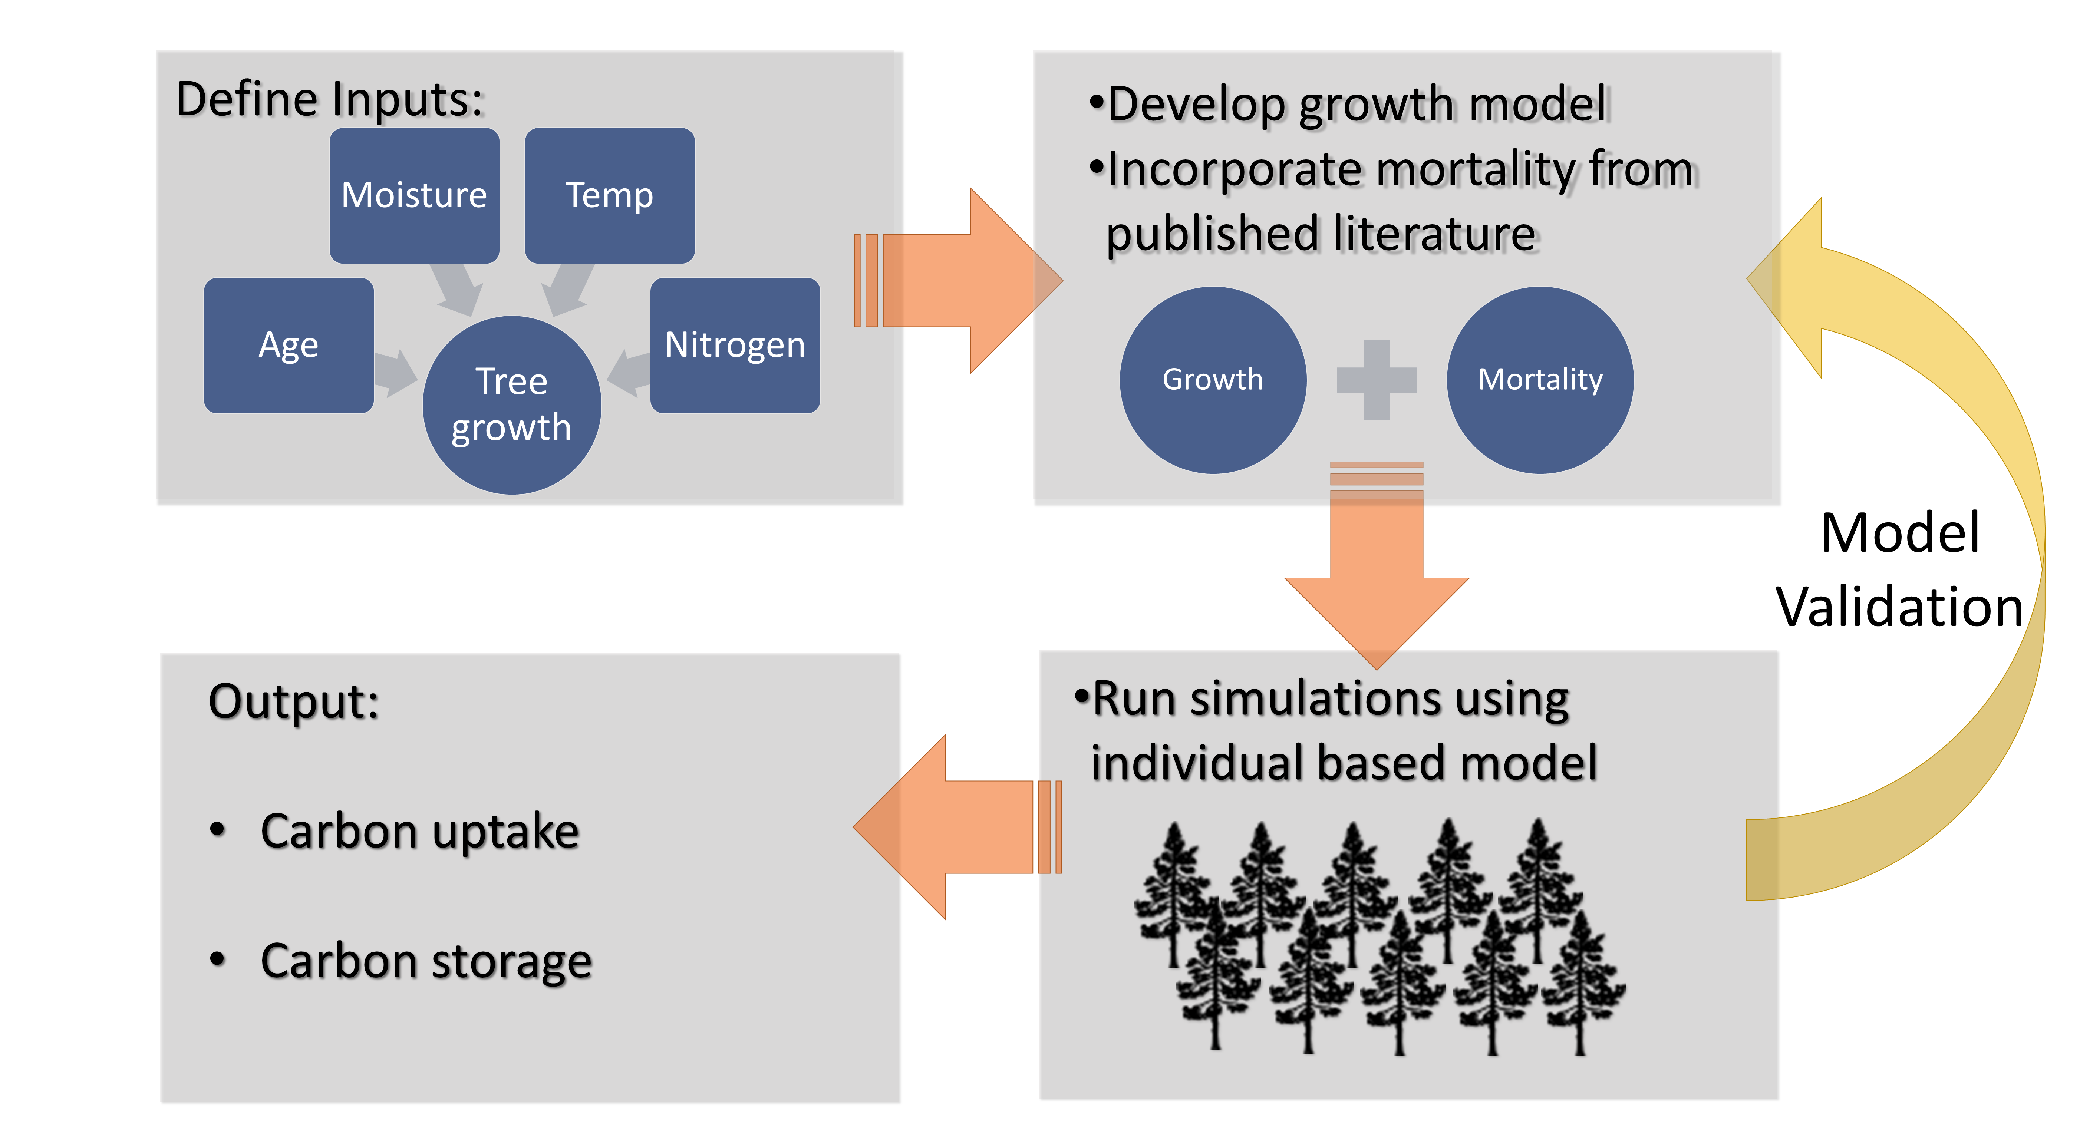
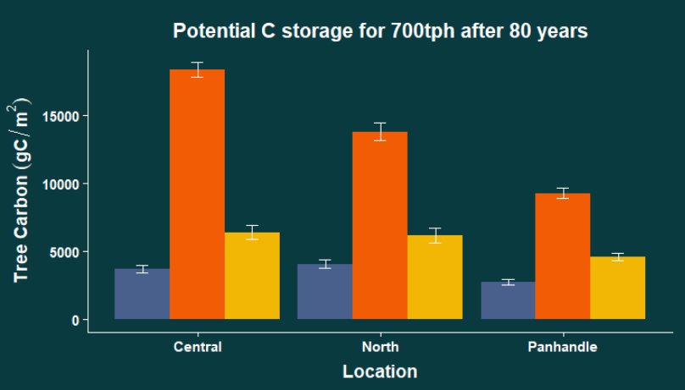
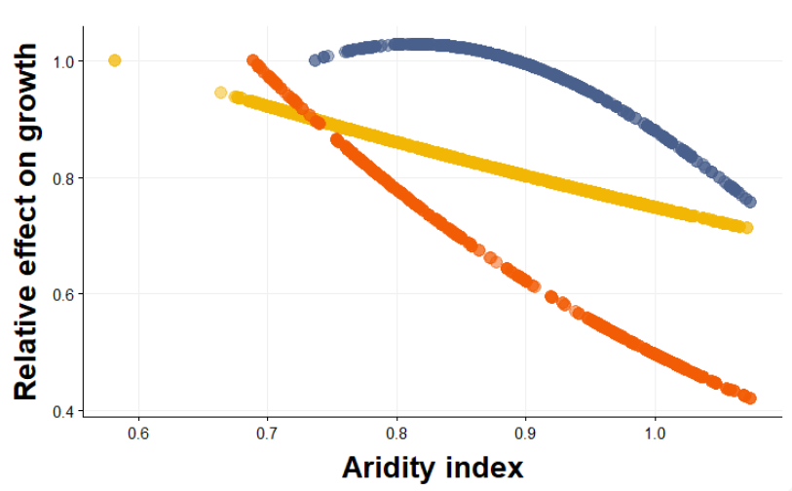
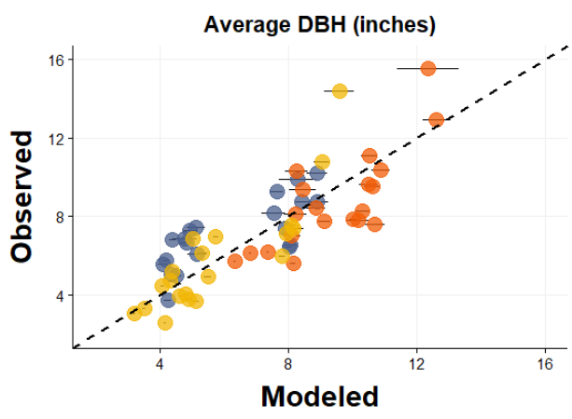
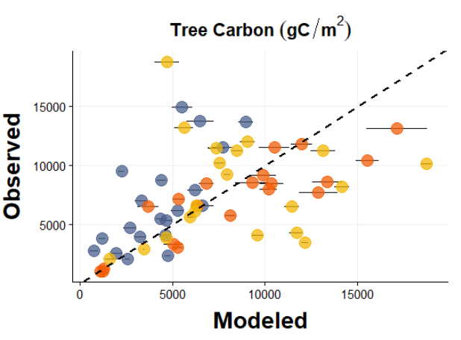


After 80 years of growth, stands dominated by longleaf pine sequestered 3 to 5 times the amount of C compared to stands dominated by loblolly pine and over 2 times the amount of C as stands dominated by slash pine.
Non-Cognitive Predictors of Student Success: A Predictive Validity Comparison Between Domestic and International Students
INTRO
Tree restoration has the largest global potential to mitigate the effects of climate change through photosynthetic carbon (C) capture and storage¹. The magnitudes of tree C uptake and mortality rates – which control C storage – vary across species as well as climatic and edaphic conditions^{2,3}
Evaluating carbon (C) uptake and storage potential across tree species and environmental gradients in Florida
Alicia Formanack and Oleksandra Hararuk
Tree growth was affected by…
Intro
Over the past two centuries the rising atmospheric CO₂ concentrations have contributed to changing climatic conditions. This has prompted the development of local and global mitigation plans, like the Bonn Challenge, that use natural ecosystem processes (i.e. photosynthetic carbon capture and storage by trees) to offset the rising atmospheric CO₂. Reforestation, avoided forest conversion, and forest management have some of the largest mitigation potential on a global scale due to the wide geographic range of forest biomes and their relatively fast rate of C capture¹. The magnitudes of tree C uptake and mortality rates – which control C storage – vary across species as well as climatic and edaphic conditions.^{2,3} Thus selecting a species to be restored in a given area requires careful evaluation of its C uptake and storage potential under given environmental conditions.
Methods
Results
F I G U R E 1 Observed versus simulated average diameter at breast height (DBH, in) across 60 forest plots, with 20 plots per species (R²=0.67). Three species were selected for the analysis: slash pine (Pinus elliottii), loblolly pine (P. taeda), and longleaf pine (P. palustris). Observed versus simulated tree above-stump biomass used to calculate tree C (Tree Carbon, g C/m²) across 60 forest plots (R²=0.23). Observed average DBH and stand-level tree C estimates are from the FIA database (USDA Forest Service).
Age
Diameter increments decrease with age
P. taeda grows the fastest
Young
Soil CN
Old
Growth is limited by soil N (except for P. elliottii)
N limitation is offset by wet conditions (not shown)
P. palustris is more sensitive to soil N than P. taeda
High N
Low N
Aridity
Pines in Florida grow better in drier conditions
P. palustris is more sensitive to increasing moisture than P. taeda and P. elliottii
Loblolly
Longleaf
Slash
Dry
Wet
F I G U R E 3 Relative effects of age, soil CN ratio, and aridity on tree growth by species. Growth is most sensitive to age, followed by aridity and soil CN ratio, respectively. Lower values on the aridity index (MAP/PET) indicate less available moisture in the ecosystem. Not pictured is the relative effect of temperature on slash pine growth (parabolic, Topt=20.25°C).
Take-away points
Stands dominated by longleaf pine had the highest potential biomass C uptake after 80 years.
Growth was affected by site aridity, soil C:N ratio (except slash pine), and temperature (slash pine only).
Increases in aridity could increase pine growth rate, but this effect may be offset by nitrogen limitation resulting from slower organic matter decomposition.
C loss was driven by background mortality and may have been underestimated. Need to include disturbance-related mortality (fires, storm surges).
F I G U R E 2 Eighty years of growth was simulated for 700tph (trees per hectare) to evaluate C storage among three species in three different regions of Florida. Error bars reflect one standard deviation from the mean as each simulation was run 10 times to account for the stochastically implemented mortality rates. Environmental data from WorldClim (temperature), CGIAR (aridity index), and SoilGrids (soil CN ratio) was used to reflect different growing conditions of each region.
AliciaFormanack@knights.ucf.edu
References
1. Griscom, B. W. et al. Natural climate solutions. Proc. Natl. Acad. Sci. U. S. A. 114, 11645–11650 (2017). 2. Boisvenue, C. & Running, S.W. (2006) Global Change Biology 12(5): p. 862-882. 3. Van Mantgem, P.J., et al. (2009) Science 323(5913): p. 521.
Notes:
Notes:
In Powerpoint, click View > Guides
Keep text within gutter guides.
Author list: Don’t split names onto two lines (e.g., “Jimmy [break] Smith”). If that happens, use a new line, unless you need the space. Bold the first names of anybody who’s presenting in person.
Intro/methods/result: Do not drop below font size 28, but if you have extra space, jack up the font size until the space is full.
Do not use color in the sidebars except in graphs/figures. It’ll pull attention from the center and slow interpretation for passersby.

